Slide 1
Hyperspectral Image Classification
MMFormer vs. R2Mamba: A 2026 Benchmark
Evaluating cutting-edge 2026 Vision Transformer vs. State Space Model architectures
under identical few-shot conditions on remote sensing HSI benchmarks
Ayush Bansal · Prince Prajapati · Abhay Kaushal
Department of Computer Science & Engineering | Academic Year 2026

Slide 2
Agenda
What we will cover today
1
Background & Motivation — What is Hyperspectral Imaging (HSI)?
2
Architectural Evolution — CNNs → Transformers → Mamba / SSMs
3
Problem Statement & Research Objectives
4
Competing 2026 Models — MMFormer (IEEE TGRS) vs. R2Mamba (IEEE JSTARS)
5
Phase 1: Pipeline Validation — Baseline CNN & Transformer models
6
Benchmark Datasets & Experimental Protocol
7
Quantitative Results — OA / AA / Kappa (Mean ± Std, 3 Seeds)
8
Qualitative Analysis — Classification Maps & Visual Comparison
9
Computational Complexity Analysis — O(N²) vs. O(N)
10
Conclusion & Future Work

Slide 3
Background: Hyperspectral Imaging (HSI)
Beyond standard RGB — capturing the full spectral fingerprint of materials
What is HSI?
HSI vs. RGB
▸ Normal RGB cameras capture only 3 spectral bands
▸ Hyperspectral sensors capture 100–200+ narrow contiguous bands
▸ Each pixel contains a unique spectral 'fingerprint'
▸ Enables material & chemical composition identification
RGB Camera
3 bands | Low spectral resolution
Multispectral
Real-World Applications
4–12 bands | Moderate discrimination
▸ Agriculture: Crop health, weed & moisture detection
▸ Urban Planning: Asphalt, roofs, concrete classification
▸ Planetary Science: Mars mineral mapping (NASA CRISM)
▸ Mining: Mineral exploration from satellite data
Hyperspectral
100–200+ bands | Full spectral fingerprint

Slide 4
Architectural Evolution in HSI Classification
From local convolutions to global sequence modelling
2017–2020
2021–2024
2024–2026
CNN Era
Transformer Era
Mamba / SSM Era
3D/2D Conv
SSRN · HybridSN
DBDA · pResNet
Self-Attention (SA)
SpectralFormer · MFT
GAHT · MASSFormer
Selective State Space
MambaHSI · R2Mamba
MMFormer · SSMamba
→
→
⚠ Limitation:
⚠ Limitation:
⚠ Limitation:
Local receptive fields
Cannot model long-range
spectral dependencies
Global context via SA
But O(N²) complexity
Slow on large scenes
Linear O(N) complexity
Global context + speed
Best of both worlds

Slide 5
Problem Statement & Research Objectives
Why compare the two newest 2026 architectures?
Research Gap
▸ HSI classification demands few-shot generalisation: only 10–30 labeled pixels per class
▸ Transformers dominate but suffer from quadratic O(N²) self-attention — slow on large urban scenes
▸ 2026 introduces Macro-Micro Transformers and Route-Reliability Mamba — never head-to-head compared
Research Objectives
#1 Rigorous Benchmark
#2 Statistical Robustness
#3 Efficiency Analysis
Head-to-head comparison of the two newest 2026 architectures under identical experimental conditions
3 independent seeded runs per model × dataset — reporting Mean ± Standard Deviation
Compare training latency, convergence stability, and computational complexity O(N²) vs O(N)

Slide 6
The 2026 Models: MMFormer vs. R2Mamba
Transformer-based Macro-Micro attention vs. Selective State Space scanning
MMFormer (IEEE TGRS 2026)
R2Mamba (IEEE JSTARS 2026)
▸ Architecture: Macro-Micro Vision Transformer
▸ Macro Branch: Global scene semantics across broad spatial tokens
▸ Micro Branch: Fine-grained local spectral-spatial texture
▸ Cross-Attention Fusion: Dynamic exchange between scales
▸ Complexity: Quadratic O(N²) self-attention
▸ Published: IEEE TGRS 2026
▸ DOI: 10.1109/TGRS.2026.3696892
▸ Architecture: Route-Reliability State Space Model (SSM)
▸ Sequential scanning of spatial-spectral tokens
▸ Reliability Gating: Down-weights noisy/mixed boundary pixels
▸ Linear Complexity: O(N) — scales to very large scenes
▸ Converges faster (25–40 epochs vs 40–50 for Transformer)
▸ Published: IEEE JSTARS 2026
▸ DOI: 10.1109/JSTARS.2026.3728152
VS

Slide 7
Phase 1: Pipeline Validation
Verifying the end-to-end framework before resource-intensive experiments
Why a Validation Phase?
▸ Before training expensive 2026 SOTA models, we verify every pipeline stage works correctly
▸ Confirms HuggingFace auto-download, on-the-fly PCA, patch generation, and classification map export
Baseline Models Tested
HybridSN
SSRN
pResNet
DBDA
SpectralFormer
2019 | IEEE GRSL
2017 | IEEE TGRS
2019 | IEEE TGRS
2020 | MDPI RS
2021 | IEEE TGRS
3D-2D Conv Hybrid
Spectral-Spatial ResNet
Pyramidal Residual Net
Dual-Branch Dual Attention
Spectral Transformer
✓ Passed
✓ Passed
✓ Passed
✓ Passed
✓ Passed
Result: Full pipeline confirmed — 5 models × 2 seeds × Indian Pines in ~20 min on Kaggle T4 GPU

Slide 8
Datasets & Experimental Protocol
Two standard benchmark scenes + reproducible experimental design
Indian Pines (AVIRIS Sensor)
Pavia University (ROSIS Sensor)
▸ Location: Indiana, USA — Agricultural scene
▸ Dimensions: 145 × 145 pixels
▸ Spectral Bands: 200 raw → 30 (after PCA)
▸ Target Classes: 16 crop types
▸ Challenge: Subtle spectral differences between early-growth crop stages
▸ Split: 10 train / 5 val per class (~9,482 test pixels)
▸ Location: Pavia, Italy — Dense urban infrastructure
▸ Dimensions: 610 × 340 pixels (207,400 pixels total)
▸ Spectral Bands: 103 raw → 30 (after PCA)
▸ Target Classes: 9 urban materials
▸ Challenge: High intra-class spectral variability in built surfaces
▸ Split: 30 train / 10 val per class (~40,044 test pixels)
Protocol: PCA → 30 bands | Patch 11×11 | Adam lr=0.001 | Batch 64 | Early Stop (patience=12) | 3 Seeds [1,2,3] | NVIDIA T4 GPU

Slide 9
Results: Indian Pines (16 Classes)
3-seed evaluation | 10 train / 5 val per class | ~9,482 test pixels
OA — MMFormer
OA — R2Mamba
OA Gain
Speed Gain
76.41%
83.89%
+7.48%
3× Faster
± 3.84% std
± 1.66% std
R2Mamba wins
26s vs 75s/run
Model
OA (%)
AA (%)
Kappa (×100)
Best Run OA
Avg Train Time
MMFormer (2026)
76.41 ± 3.84
87.10 ± 1.96
73.41 ± 4.28
80.81%
~75 sec
R2Mamba (2026)
83.89 ± 1.66
91.29 ± 1.09
81.71 ± 1.87
85.66%
~26 sec
Performance Delta
+7.48%
+4.19%
+8.30
+4.85%
~3× Faster
Key Observations:
▸ R2Mamba outperforms MMFormer by +7.48% in Overall Accuracy on the agricultural scene
▸ R2Mamba is significantly more stable: ±1.66% std vs ±3.84% std (2.3× lower variance)
▸ R2Mamba trains 3× faster per run (26 sec vs 75 sec) — due to O(N) linear complexity

Slide 10
Results: Pavia University (9 Classes)
3-seed evaluation | 30 train / 10 val per class | ~40,044 test pixels
OA — MMFormer
OA — R2Mamba
OA Gain
Speed Gain
92.45%
97.59%
+5.14%
3.5× Faster
± 5.98% std
± 0.60% std
R2Mamba wins
40s vs 140s/run
Model
OA (%)
AA (%)
Kappa (×100)
Best Run OA
Avg Train Time
MMFormer (2026)
92.45 ± 5.98
95.90 ± 1.80
90.44 ± 7.36
96.80%
~140 sec
R2Mamba (2026)
97.59 ± 0.60
97.95 ± 0.53
96.86 ± 0.77
98.03%
~40 sec
Performance Delta
+5.14%
+2.05%
+6.42
+1.23%
~3.5× Faster
Key Observations:
▸ R2Mamba achieves 98.03% peak OA — among the highest on record for this benchmark
▸ MMFormer shows high variance (±5.98%) due to quadratic attention sensitivity on dense urban boundaries
▸ R2Mamba converges more reliably: only ±0.60% std — nearly 10× more stable than MMFormer

Slide 11
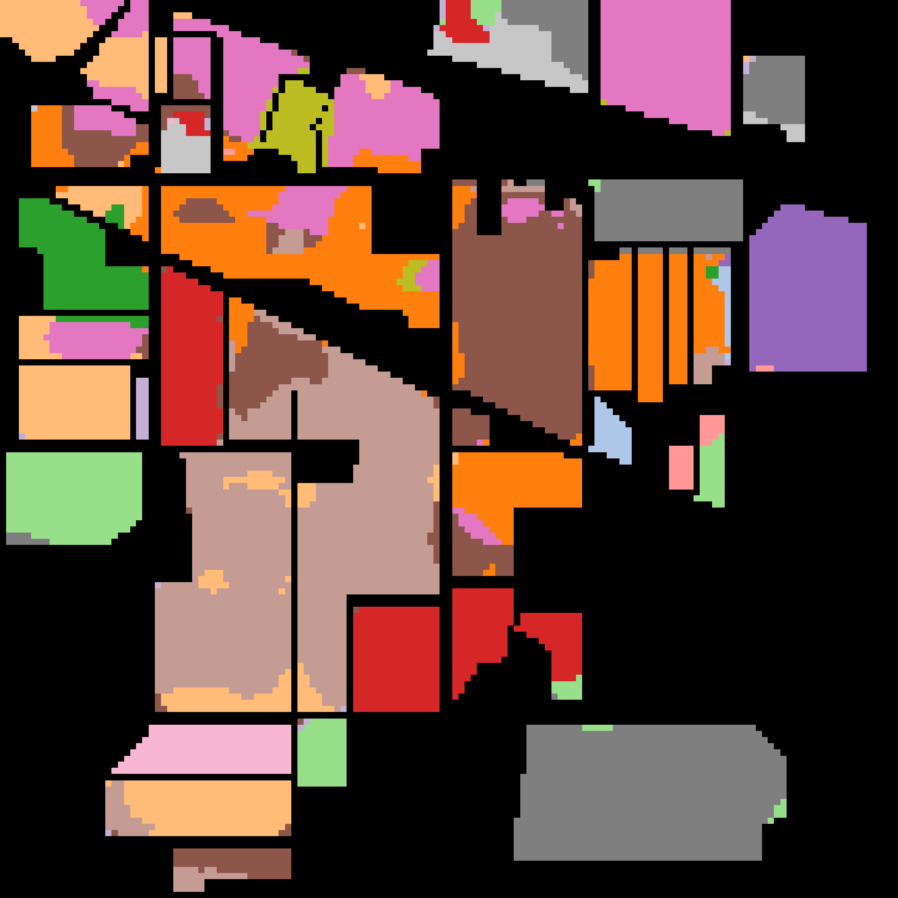

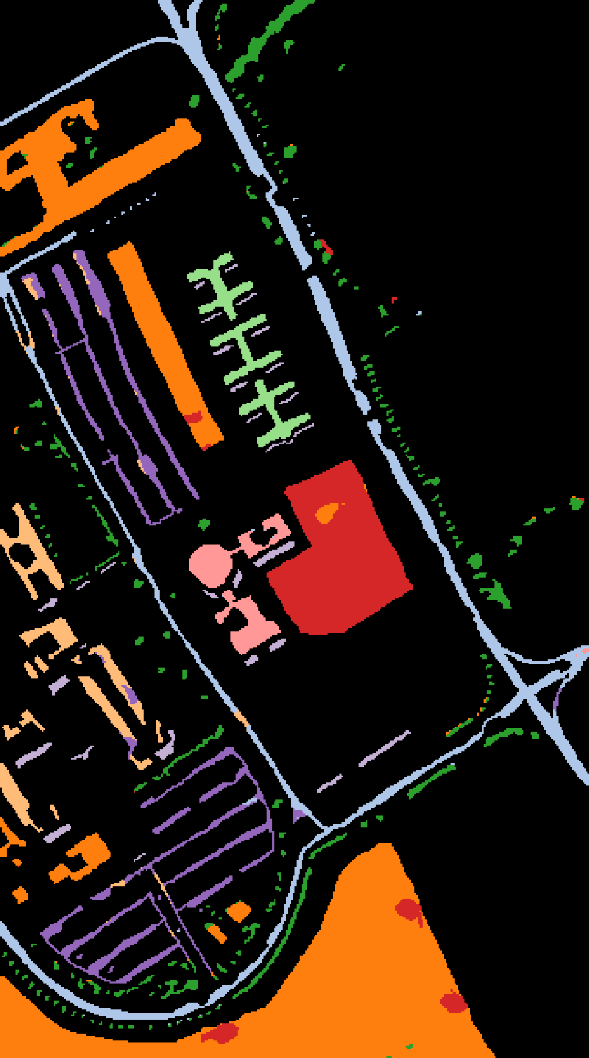
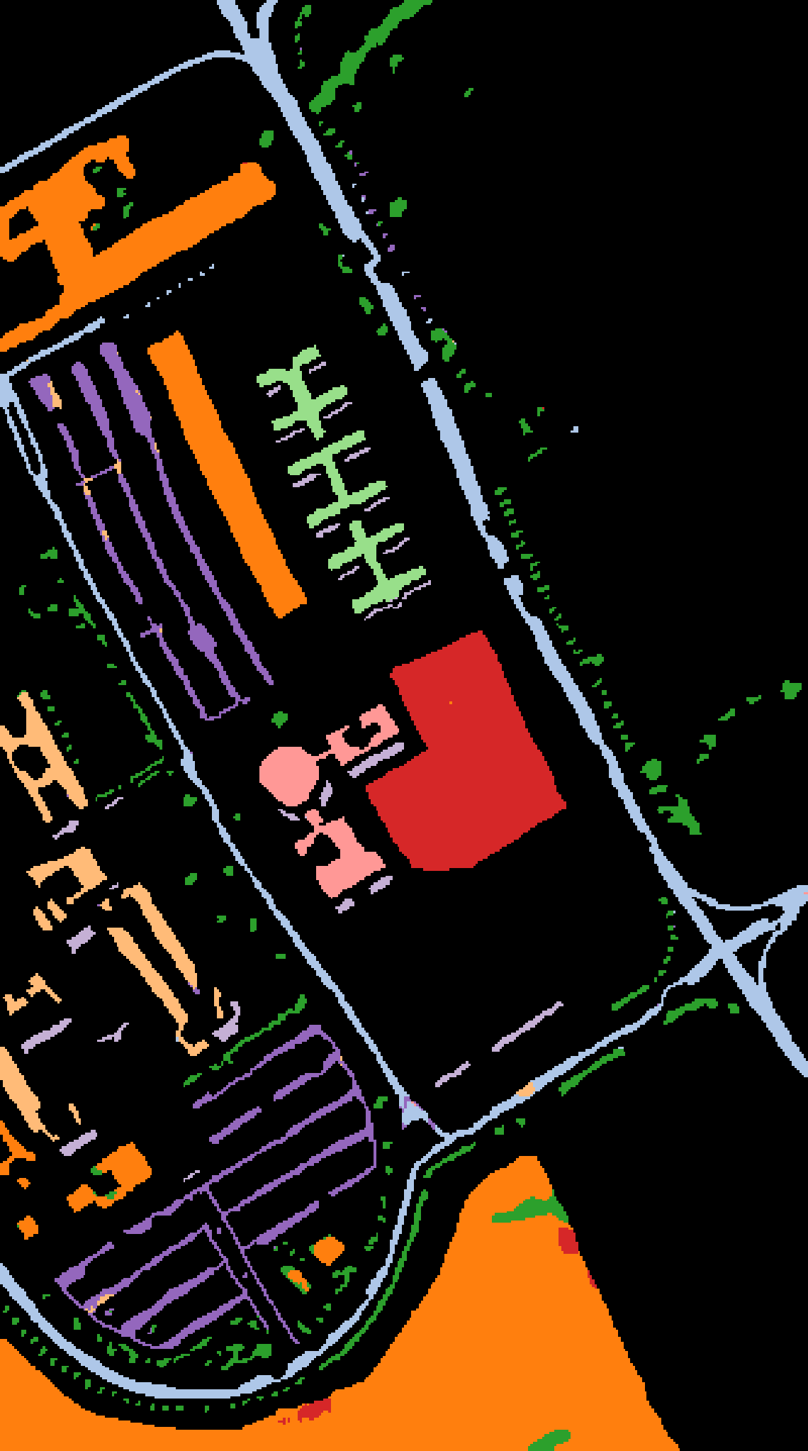
Qualitative Analysis: Classification Maps
Visual comparison of best-run spatial predictions for both models on both datasets
MMFormer (2026)
R2Mamba (2026)
Indian Pines
Pavia University
R2Mamba shows cleaner spatial boundaries, fewer noisy pixels, and better minority-class discrimination

Slide 12
Computational Complexity & Efficiency
Why linear O(N) Mamba outscales quadratic O(N²) Transformers
Aspect
MMFormer (Transformer)
R2Mamba (Mamba / SSM)
Theoretical Complexity
Quadratic O(N²)
Linear O(N)
Memory Scaling
Grows quadratically with tokens
Constant per recurrent step
Convergence Stability
High variance across seeds
Low variance, fast convergence
Avg Training Time / Run
~75s (IP) / ~140s (PU)
~26s (IP) / ~40s (PU)
Speed Advantage
Baseline
3× – 3.5× Faster
Large Scene Scalability
Challenging (memory bottleneck)
Efficient at any scale
Practical Implication:
▸ For large urban scenes (e.g. Houston 2018: 1,202 × 4,768 pixels), the quadratic bottleneck makes MMFormer infeasible
▸ R2Mamba's O(N) selective scanning enables deployment on satellite edge hardware and real-time airborne sensors

Slide 13
Conclusion & Future Work
Key findings, contributions, and next steps
Key Contributions
Future Work
▸ First rigorous benchmark comparing the two newest 2026 Transformer and Mamba HSI architectures
▸ Demonstrated R2Mamba superiority: +5% – +7.5% higher OA across two standard scenes
▸ Showed 3–3.5× training speed advantage with dramatically lower prediction variance
▸ Fully reproducible: Open-source YAML config, seeded protocol, LaTeX tables and publication maps
▸ Modular pipeline: Readily extensible to any of 56 models across 24 datasets
▸ UAV Datasets: Evaluate on WHU-Hi series (HanChuan, HongHu, LongKou) for drone-based scenes
▸ Multimodal Fusion: Extend R2Mamba to fuse hyperspectral cubes with LiDAR elevation data
▸ Model Compression: Knowledge distillation for edge deployment on satellite hardware
▸ Planetary Science: Apply to Mars CRISM datasets (Holden, NiliFossae, Utopia) already in the framework
▸ More Datasets: Salinas, Houston13/18, Chikusei for broader generalizability

Slide 14
Thank You
Questions & Discussion
Project Repository:
github.com/lPrincel/HSI-Classification-Minor-Project
MMFormer (IEEE TGRS 2026) | R2Mamba (IEEE JSTARS 2026)
Indian Pines (NASA AVIRIS) | Pavia University (DLR ROSIS)
Framework: arXiv 2609.39871 | Platform: Kaggle T4 GPU
Ayush Bansal · Prince Prajapati · Abhay Kaushal

